Slide 1
EHA Early Retiree Options for Health Insurance for 2017-2018 and How to sign up for an HSA
How to make the best decision for you!
www.nsea.org/retired

Slide 2
Review of options
Current $900 deducible PPO plan
To maintain, do nothing!
Other options available
$2,000 deductible PPO plan
To start, call Blue Cross for application
$3,500 HDHP plan
Call Blue Cross for application, consider enrolling in Health Savings Account (HSA)
$4,000 HDHP plan

Slide 3
BC/BS rates for 2017-2018 Includes Option 2 PPO Dental rate per plan (100% A, 75% B & 50% C)
Employee Ee&spouse Ee&child Ee&family
$900 ded. $636.60 $1,336.83 $1,177.69 $1,795.07
$1,150 ded. $616.09 $1,293.78 $1,139.79 $1,737.27
$1,500 ded. $591.41 $1,241.94 $1,234.77 $1,667.66
$2,000 ded. $541.59 $1,137.33 $1,130.16 $1,527.18
$3,500 HSA $541.59 $1,137.33 $1,130.16 $1,527.18
Retirees before Age 65
$900 ded. $697.39 $1,464.47 $1,238.46 $1,855.98
$2,000 ded. $592.90 $1,245.02 $1,053.19 $1,578.56
$3,500 HSA $592.90 $1,245.02 $1,053.19 $1,578.56
For EHA rates: www.ehaplan.org
Fall 2011
Notes:
3
Go to the EHA web site for current insurance rates.

Slide 4
How can you decide which EHA plan to choose?
Consider what you paid for health care last year in:
Office visit co-pay
Deductible for medical care
Co-pay for medical care
Co-pay for prescriptions
Premium saving for making a change

Slide 5
Example of Costs for 6 office visits (2 primary care & 4 specialty), $800 in tests, and 2 drugs per month
$900 PPO |  |  | $2,000 PPO |  |  | $3,500 HDHP
6 o.v. @ $30 &$50 | $260 |  | 6 o.v. @ $45 &$65 | $350 |  | 6 o.v. @ $195 | $1,170
Ded. for tests | $800 |  | Ded. for tests | $800 |  | Ded. for tests | $800
24 Rx @ $40 | $960 |  | 24 Rx @ $45 | $1,080 |  | 24 Rx @ $80 | $1,920
Co-pay @ 80/20 | $0 |  | Co-pay @ 70/30 | $0 |  | Total charges of $3,890 exceeds $3,500 deductible
Cost Prem sav Total | $2,020 $0 $2,020 |  | Cost Prem sav Total | $2,230 $ -1,253 $977 |  | Cost Prem sav Total | $3,500 $ -1,253 $2,247
No tax break |  |  | No tax break |  |  | Tax break for $4,450 @30% Net cost | $ -1,300 $ 947
Fall 2011

Slide 6
Plan Comparison for single coverage
Feature | $900 ded. |  | $2,000 ded. |  | $3,500 ded. HDHP
Deductible | $900 |  | $2,000 |  | $3,500
Max co-insurance | $3,750* |  | $4,850* |  | n/a
Max out of pocket (with deductible) | $4,650* |  | $6,850* |  | $3,500
Office visit | $30 & $50 & $75 |  | $45 & $65 & $90 |  | Inc. in ded.
Coins. | 80/20 |  | 70/30 |  | Inc. in ded.
Drugs – % copay $ minimums | 25% / 50% $5 / $40 / $70 |  | 30% / 50% $7 / $45 / $70 |  | Inc. in ded.
Routine care | Benefits for covered services are paid at 100%, subject to age, gender and frequency limits
Premium savings | None | $1,253 per year |  | $1,253 per year PLUS tax break
* Includes copays for both medical and pharmacy claims

Slide 7
Example of out-of-pocket cost
Hypothetical out-of-pocket expense | $900 PPO | $2,000 PPO | $3,500 HDHP
$900 in covered charges | You pay entire amount $900 | You pay entire amount $900 | You pay entire amount $900
$2,000 in covered charges | $900 applied to deductible; $1,100 paid 80/20%: You pay $1,120 | You pay entire amount $2,000 | You pay entire amount $2,000
$25,000 in covered charges | $900 applied to deductible; co-insurance max. is $3,750*: member pays $4,650 (*Co-insurance max. also includes drug co-pays) | $2,000 applied to deductible; co-insurance max. is $4,850*: member pays $6,850 (*Co-insurance max. also includes drug co-pays) | $3,500 applied to deductible; 100% coverage after deductible: member pays $3,500
Fall 2011

Slide 8
To make a change, do this:
Call Blue Cross at 1-800-562-6394
Tell them you are with EHA
Ask for application to change policy
Have your Blue Cross ID number ready
Fill out application and return to Blue Cross
If you want to open a Health Savings Account, contact Union Bank (or your financial provider) after you sign up for the HDHP
Go to EHA web site, www.ehaplan.org, for details on the plans available
Go to Union Bank web site, www.ubt.com/health

Slide 9
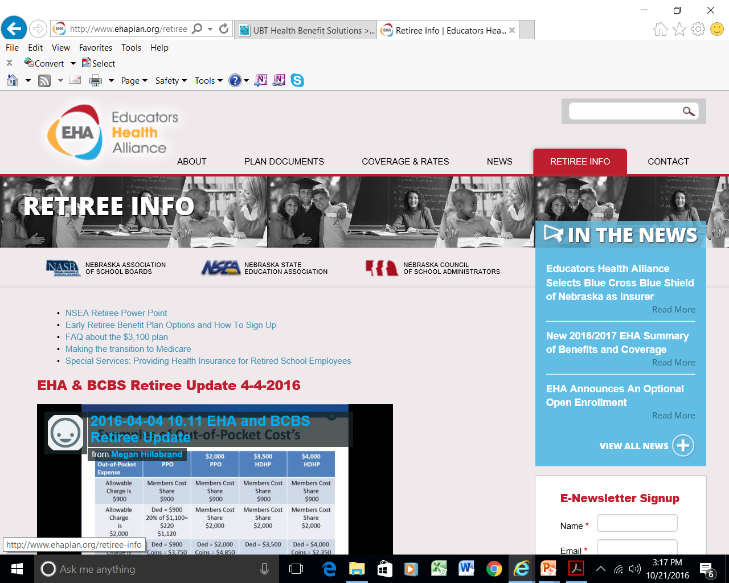
www.ehaplan.org
Click here to see retiree information

Slide 10
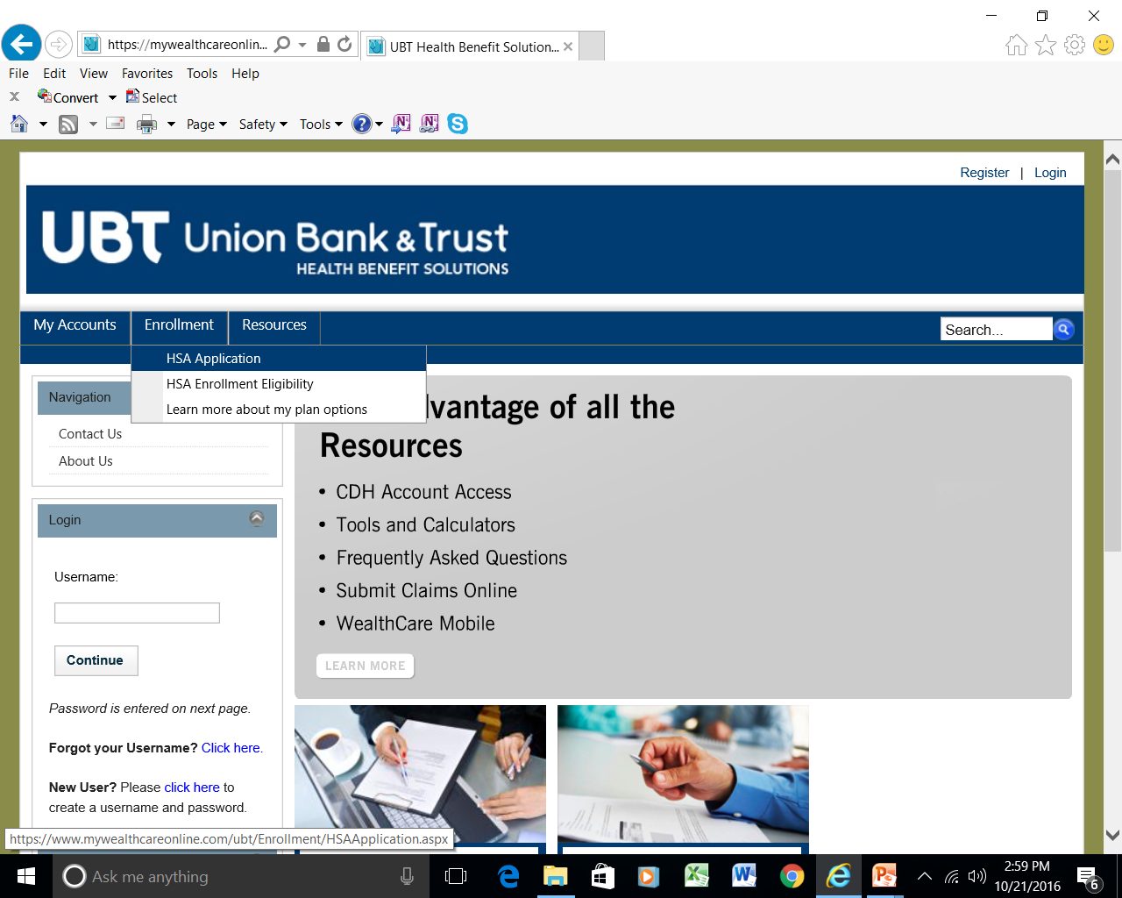
From the Union Bank web site: www.ubt.com/health
This screen pops up
Click on “Enrollment” and then “HSA Application” to open an account online

Slide 11
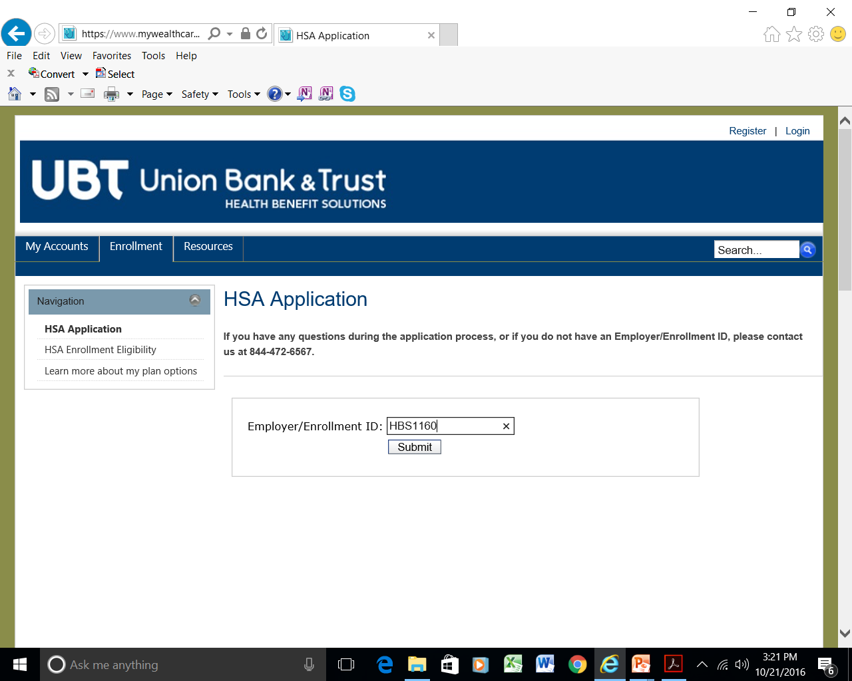
This page opens.
The EHA Employer ID is:
HBS1160
Then click, “Submit”

Slide 12
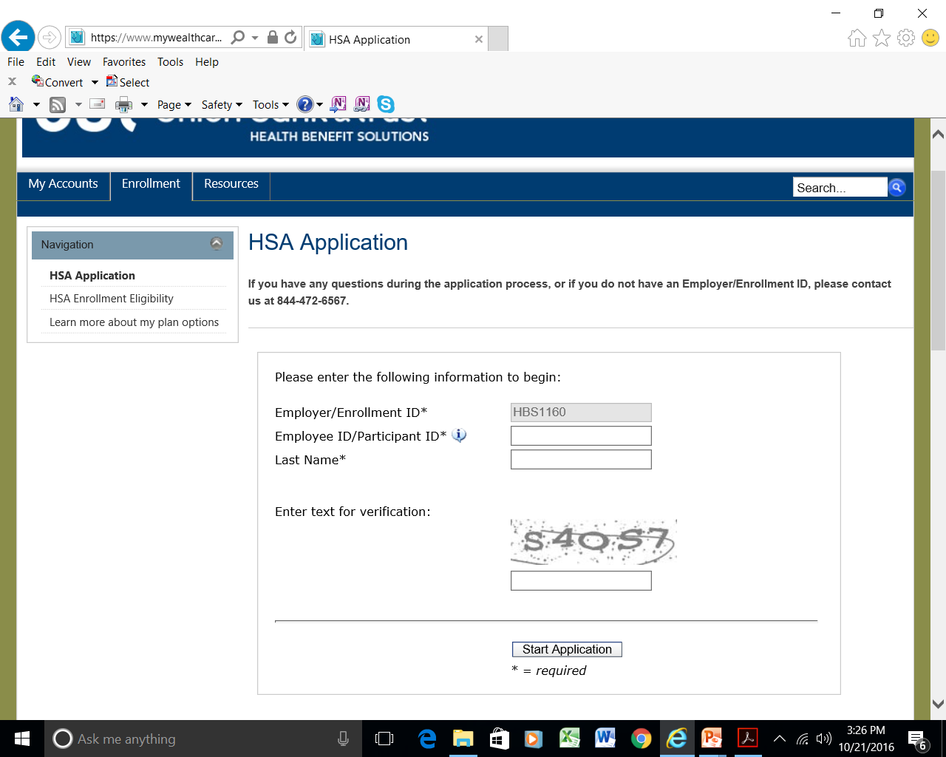
Your Employee ID is your Social Security Number, no dashes or spaces!
Confirm the “text,” then click, “Start Application”

Slide 13
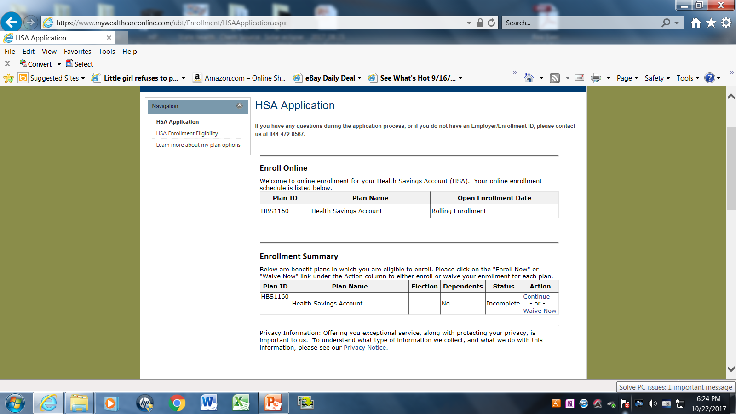
Click on
“Enroll Now,” or “Continue” to begin the process

Slide 14
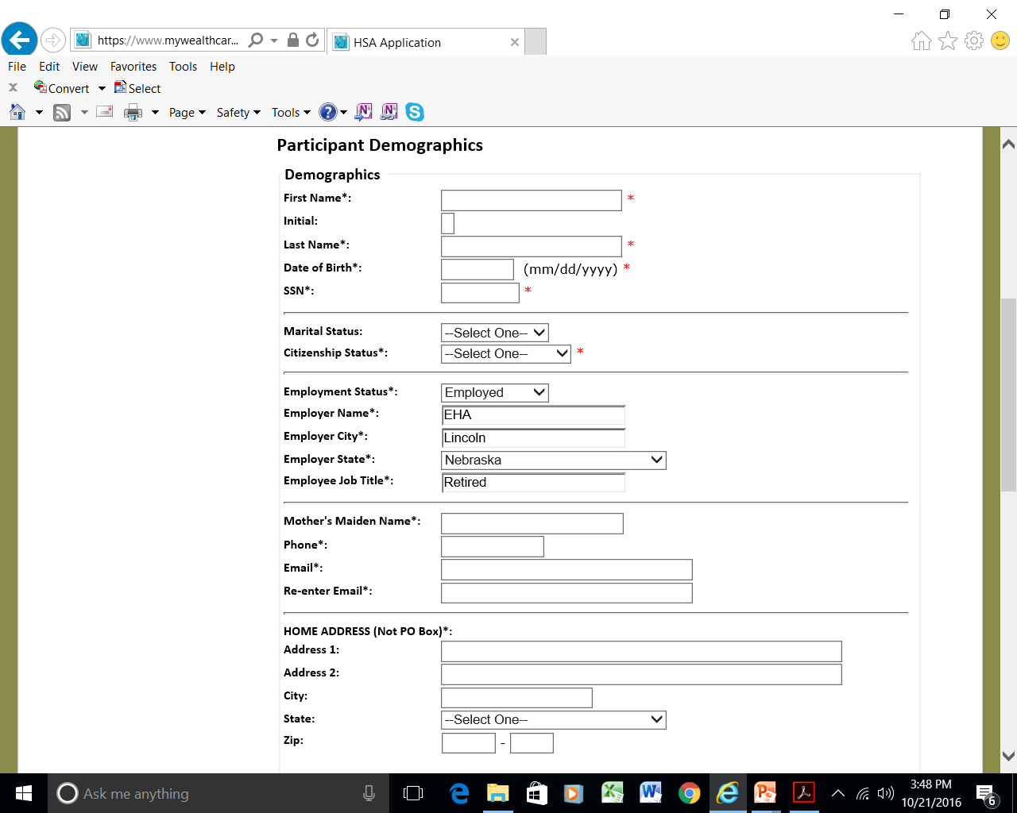
Enter your information
For employment status, select “Employed” to get low-fee HSA. Your employer will be “EHA,” your job title is “Retired”

Slide 15
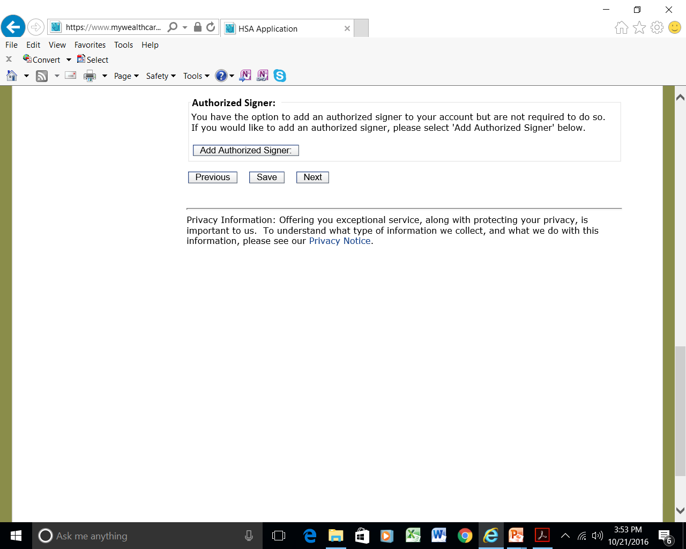
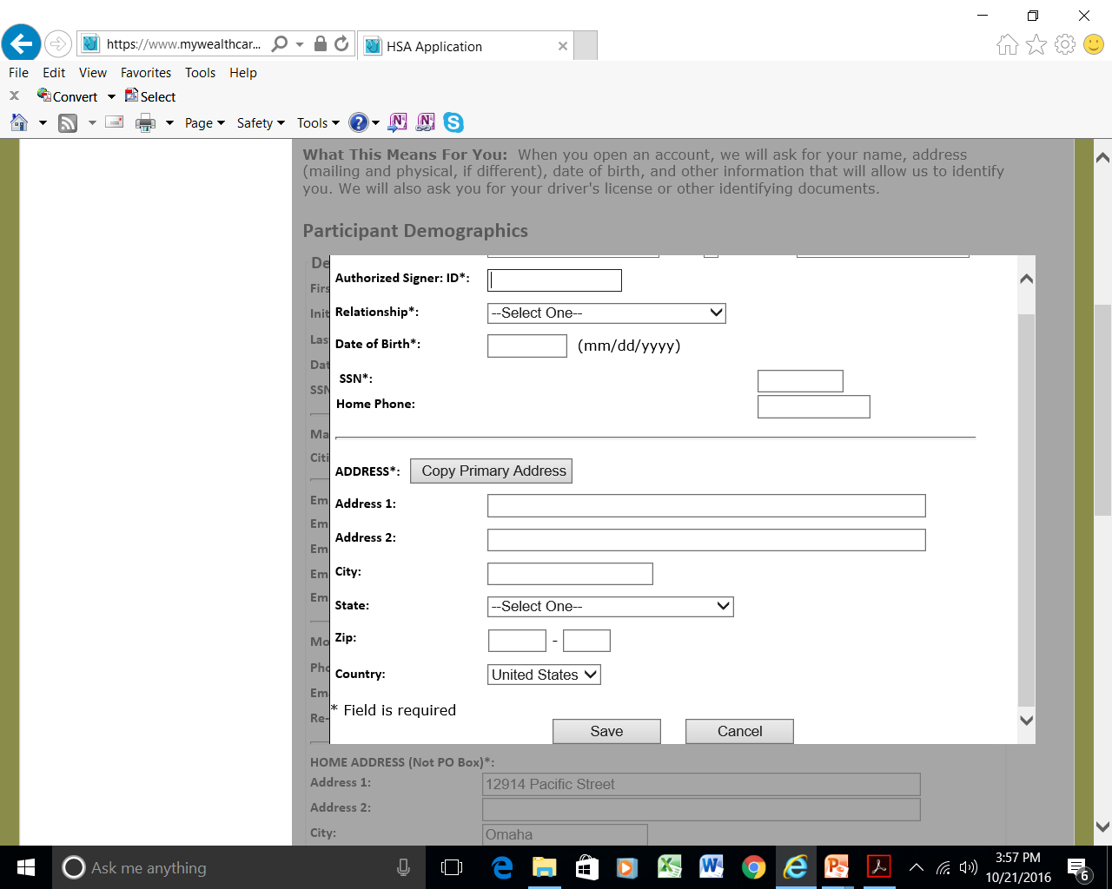
You can add an authorized signer if you wish – it can be your spouse – even if they are not covered directly by the HDHP insurance policy
Enter info for authorized signer on this pop-up screen

Slide 16
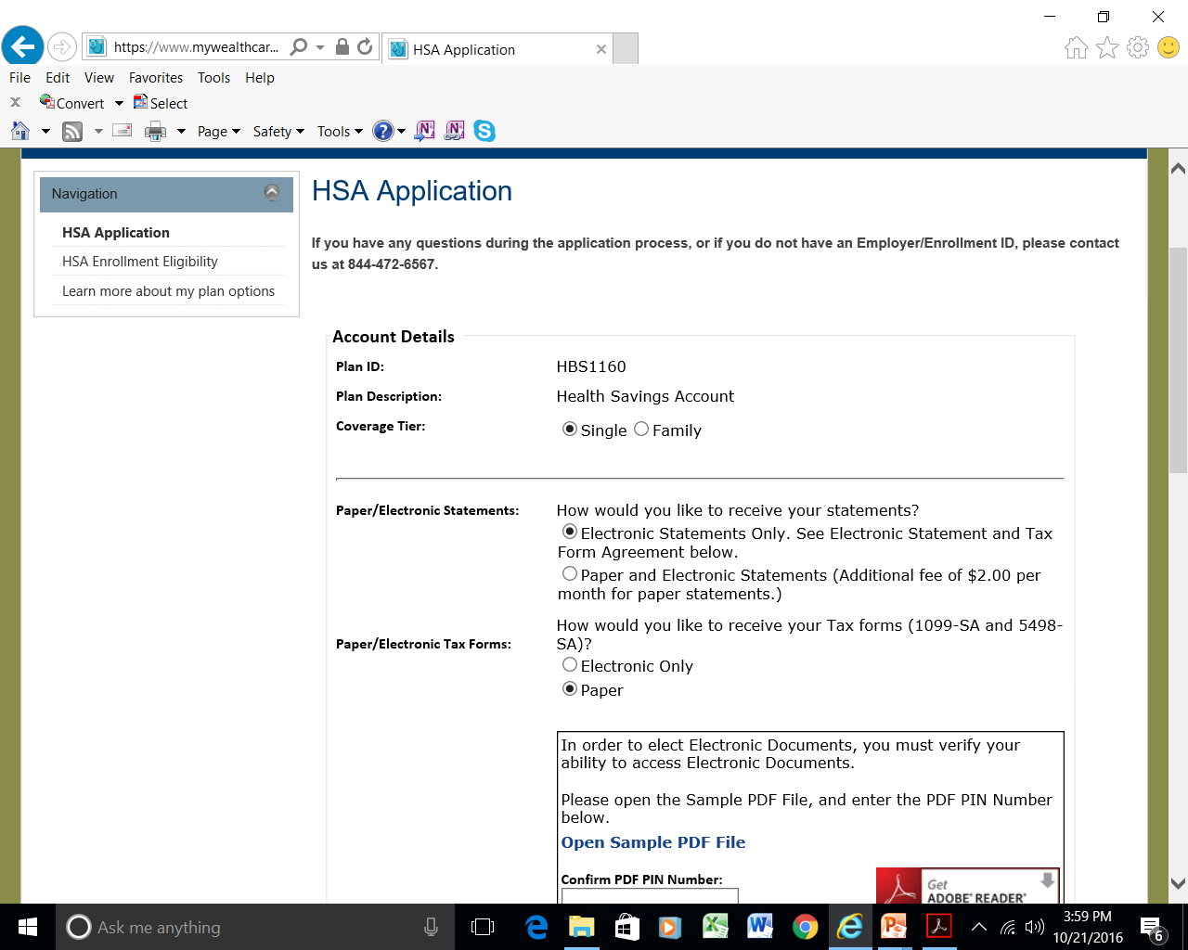
Select what kind of statements and tax forms you want, electronic or paper (paper statements are $2 per month extra)
If you choose electronic documents, open this file for a code number

Slide 17
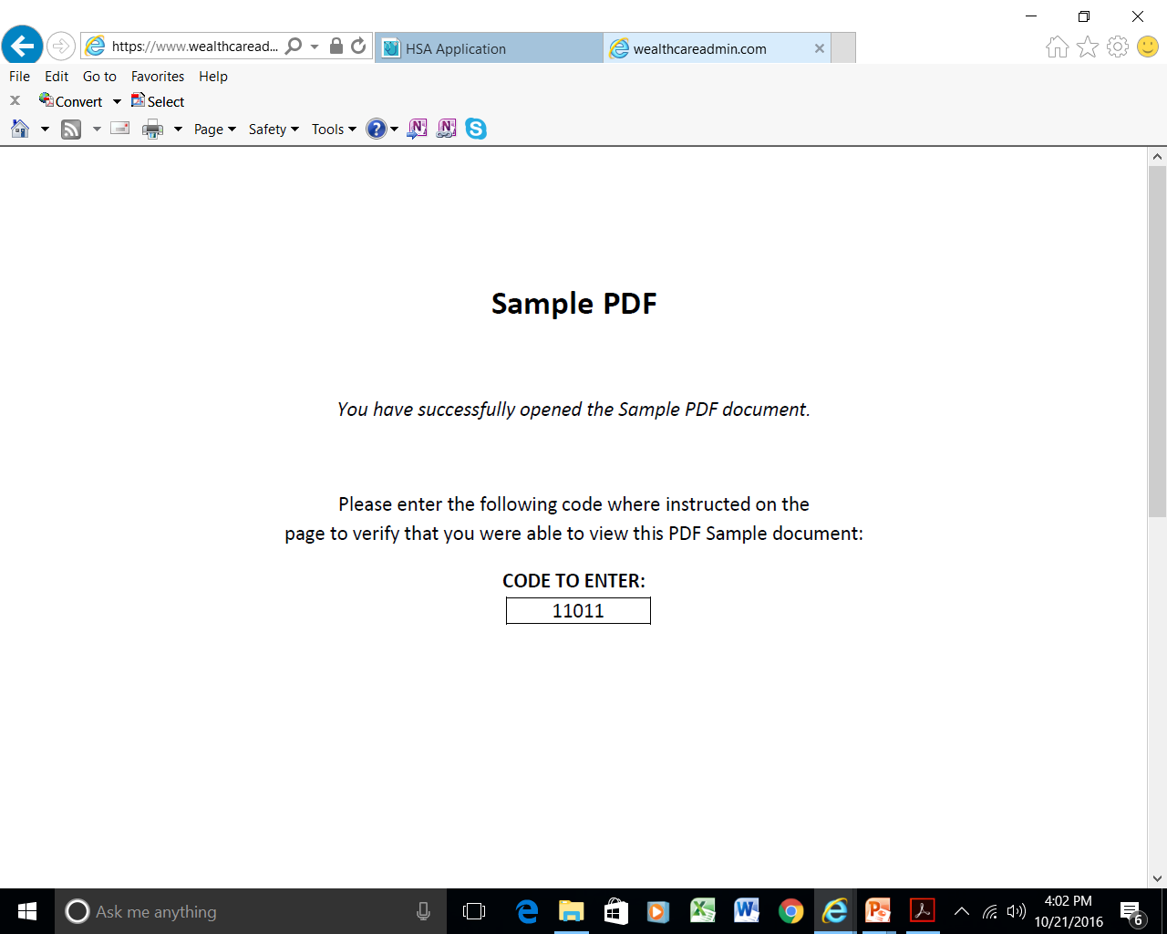
If you choose electronic documents, enter the code on the line in the prior screen

Slide 18
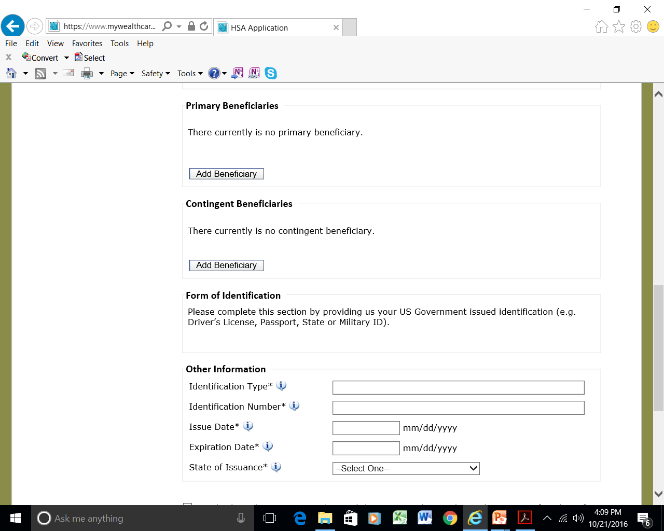
You can add beneficiaries now (or later), or use your will or estate plan to control who gets any remaining money if you die with an unused account balance

Slide 19
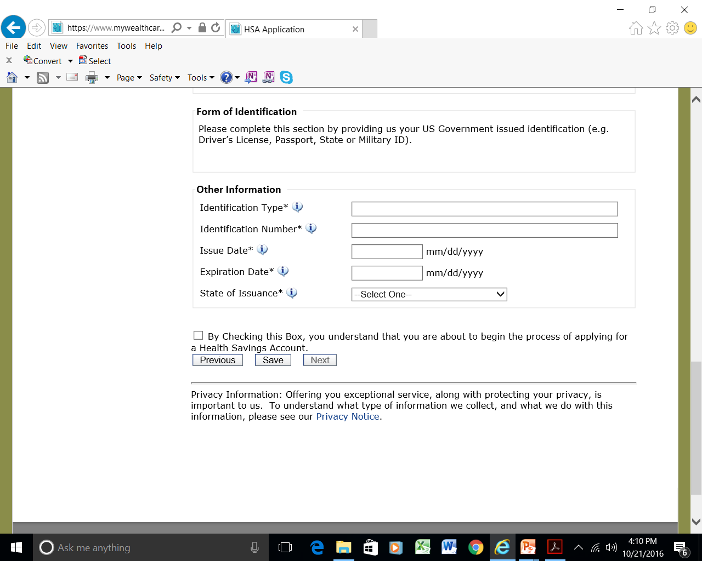
You will also need to provide some form of government-issued ID information

Slide 20
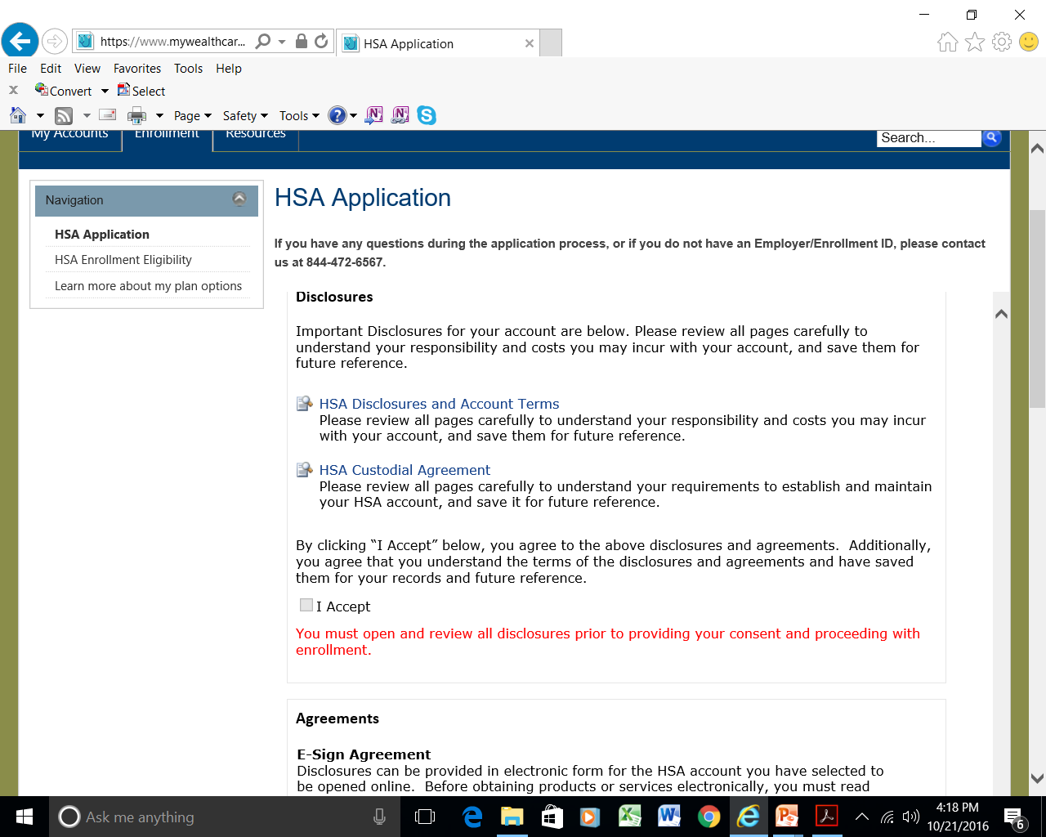
A summary of all information you entered will be next, and you can edit anything that is not OK.
You must open all of the disclosures to complete the application.

Slide 21
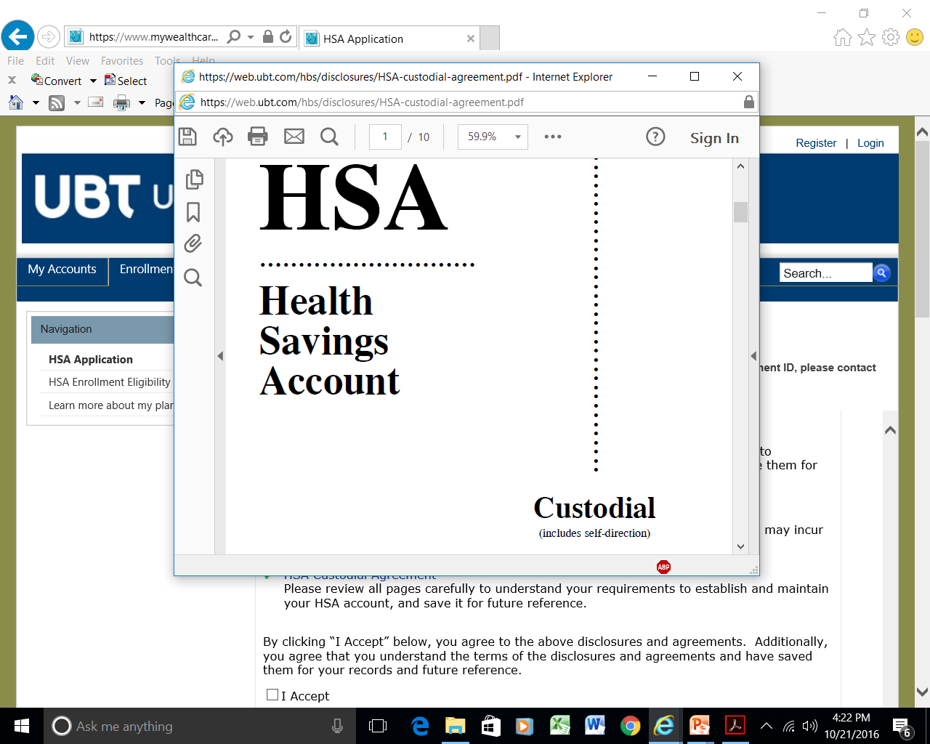
Read the disclosures, then “accept”

Slide 22
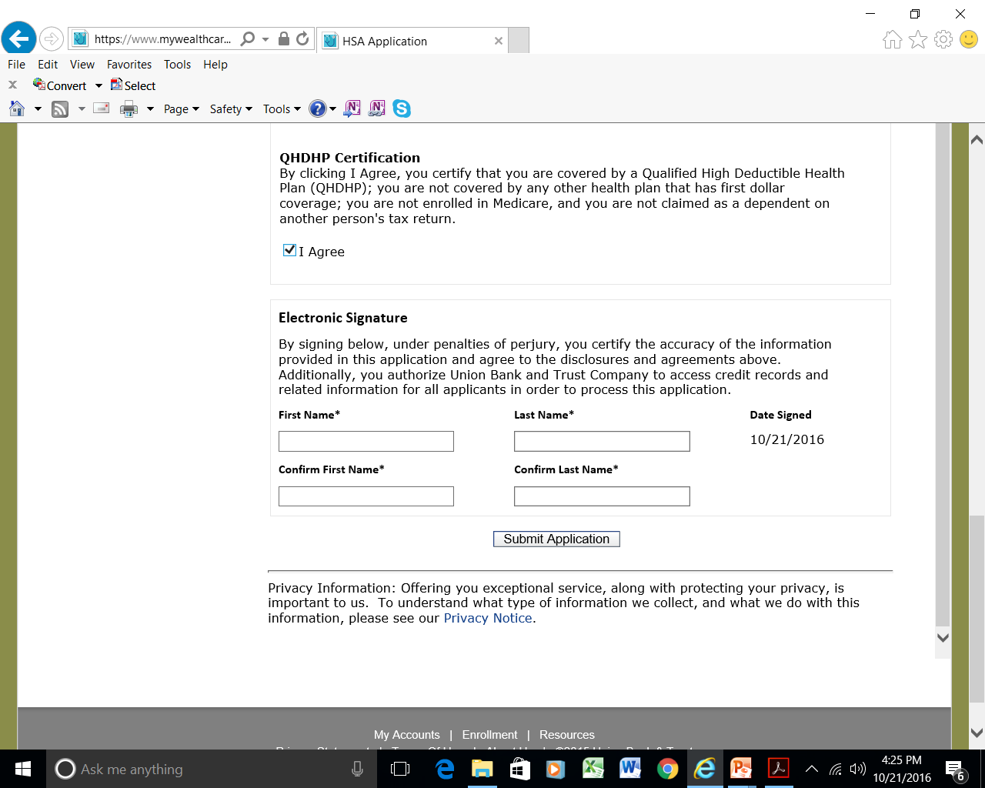
Agree to all of the other terms, add your electronic signature, then submit application.

Slide 23
Last steps for HSA account
You will get an email confirming your application, and a link to an HSA Welcome Kit
Wait for your ID card to be issued (it is a debit card that can be used for office visit costs, drug costs, etc.)
FUND your account by making check payable to Union Bank and mailing in your funding deposit
Must wait until after January 1 of the year you will use the HSA

Slide 24
If you change plans, you will need to stay in the plan you choose for 3 years before you can switch back to the older plan. You can change by August 1, or Dec. 1, or next year…. Questions?

